Slide 1
scTDA tutorial
Quanhua Mu
Bioengineering Graduate Program

Slide 2
Outline
Introduction to single cell RNA sequencing(scRNA-seq)
Introduction to scRNA-seq data analysis
Case study: human embryo development at single-cell resolution

Slide 3
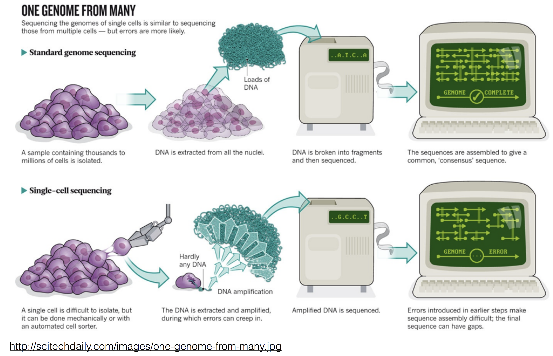
Single cell RNA sequencing
Why single cell?
Remove ensemble average
Discover rare species
Reveal mechanism

Slide 4
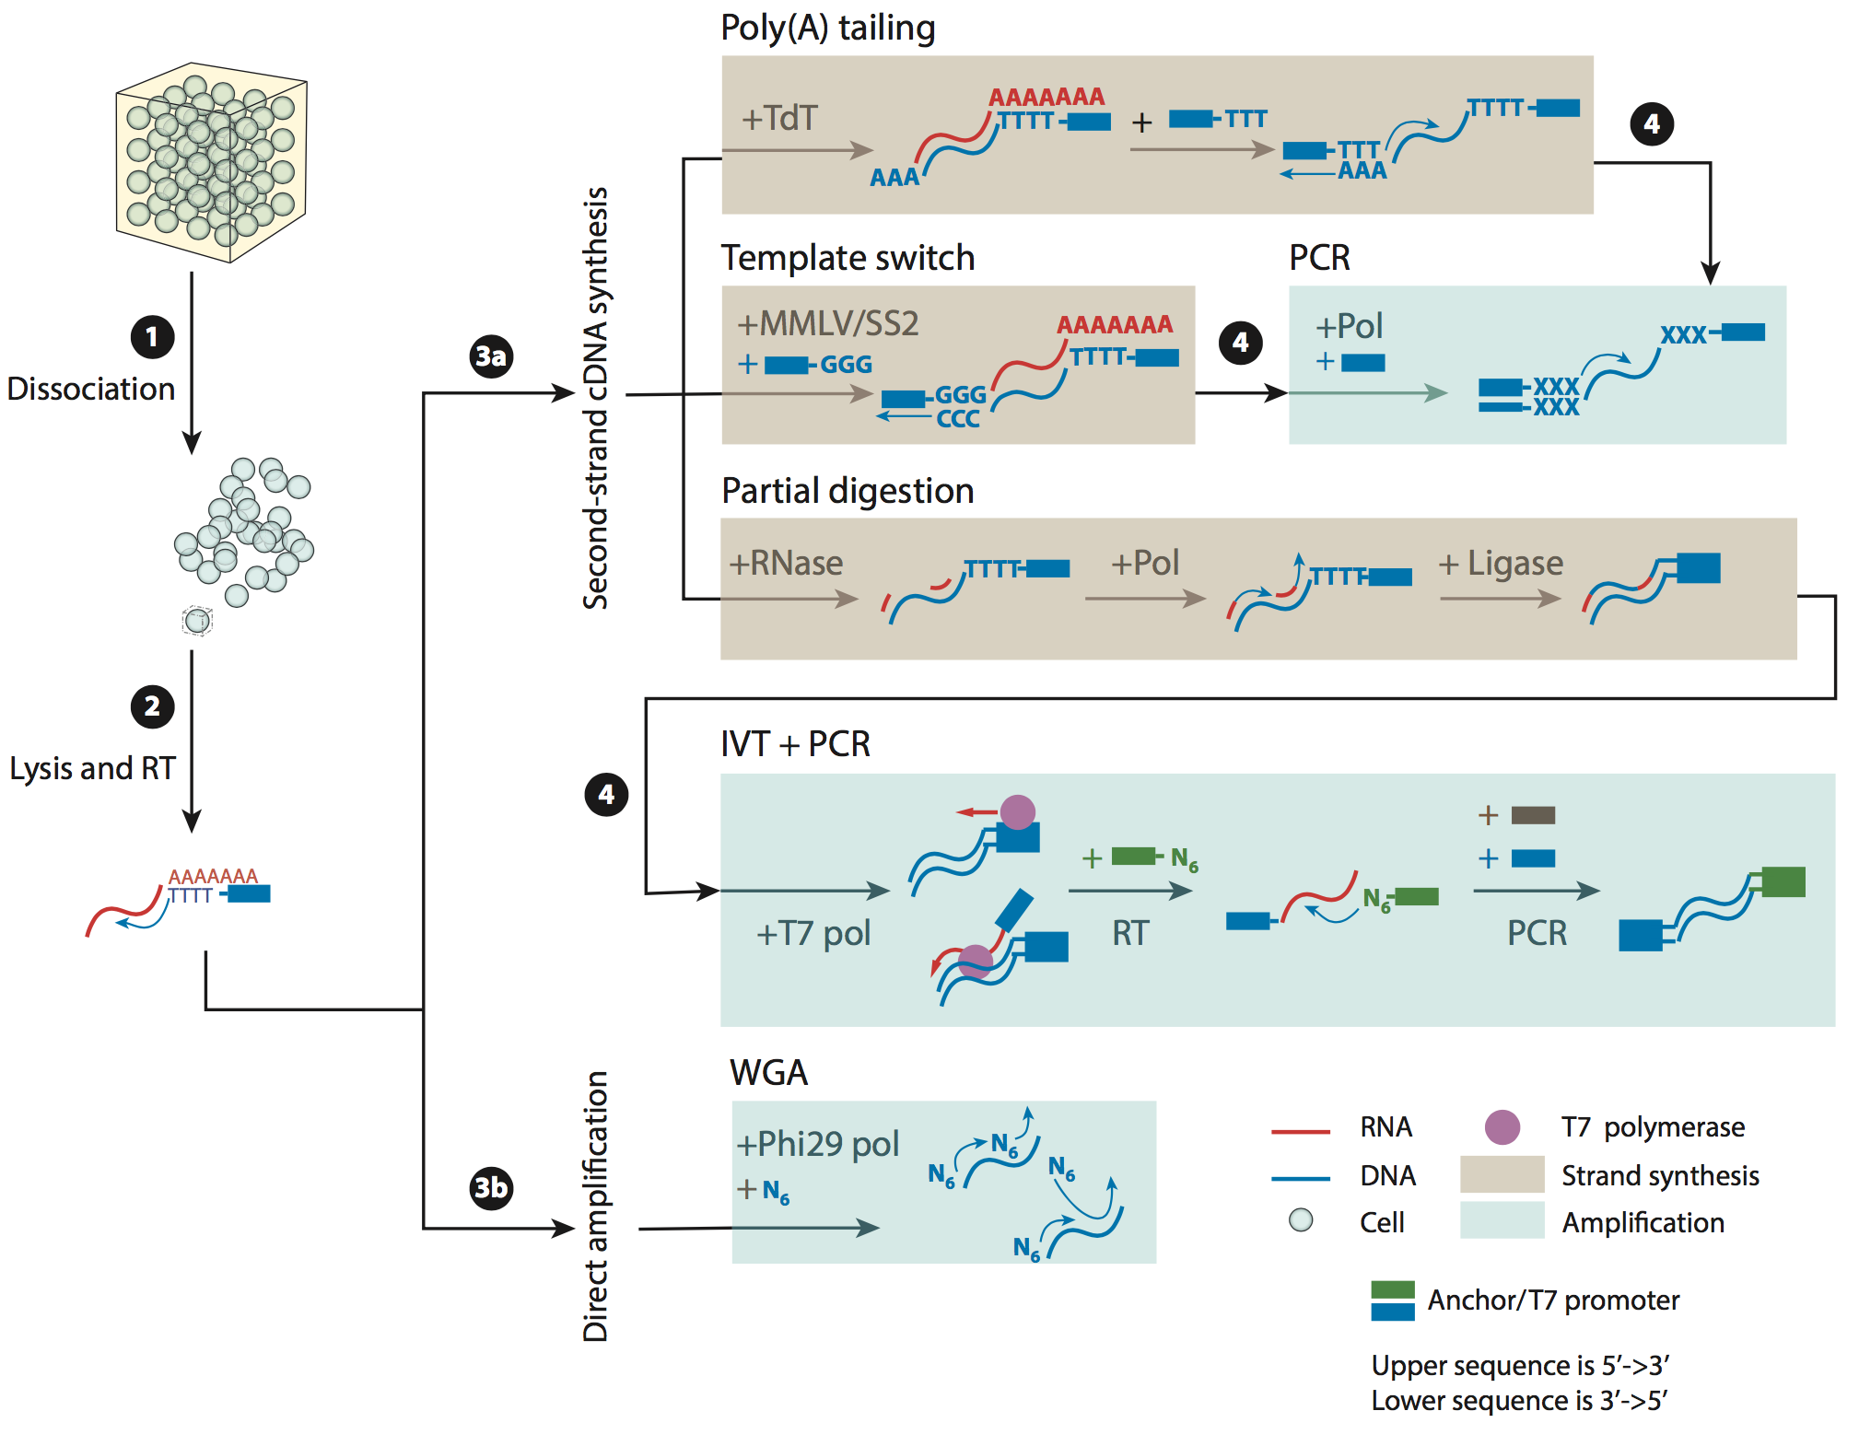
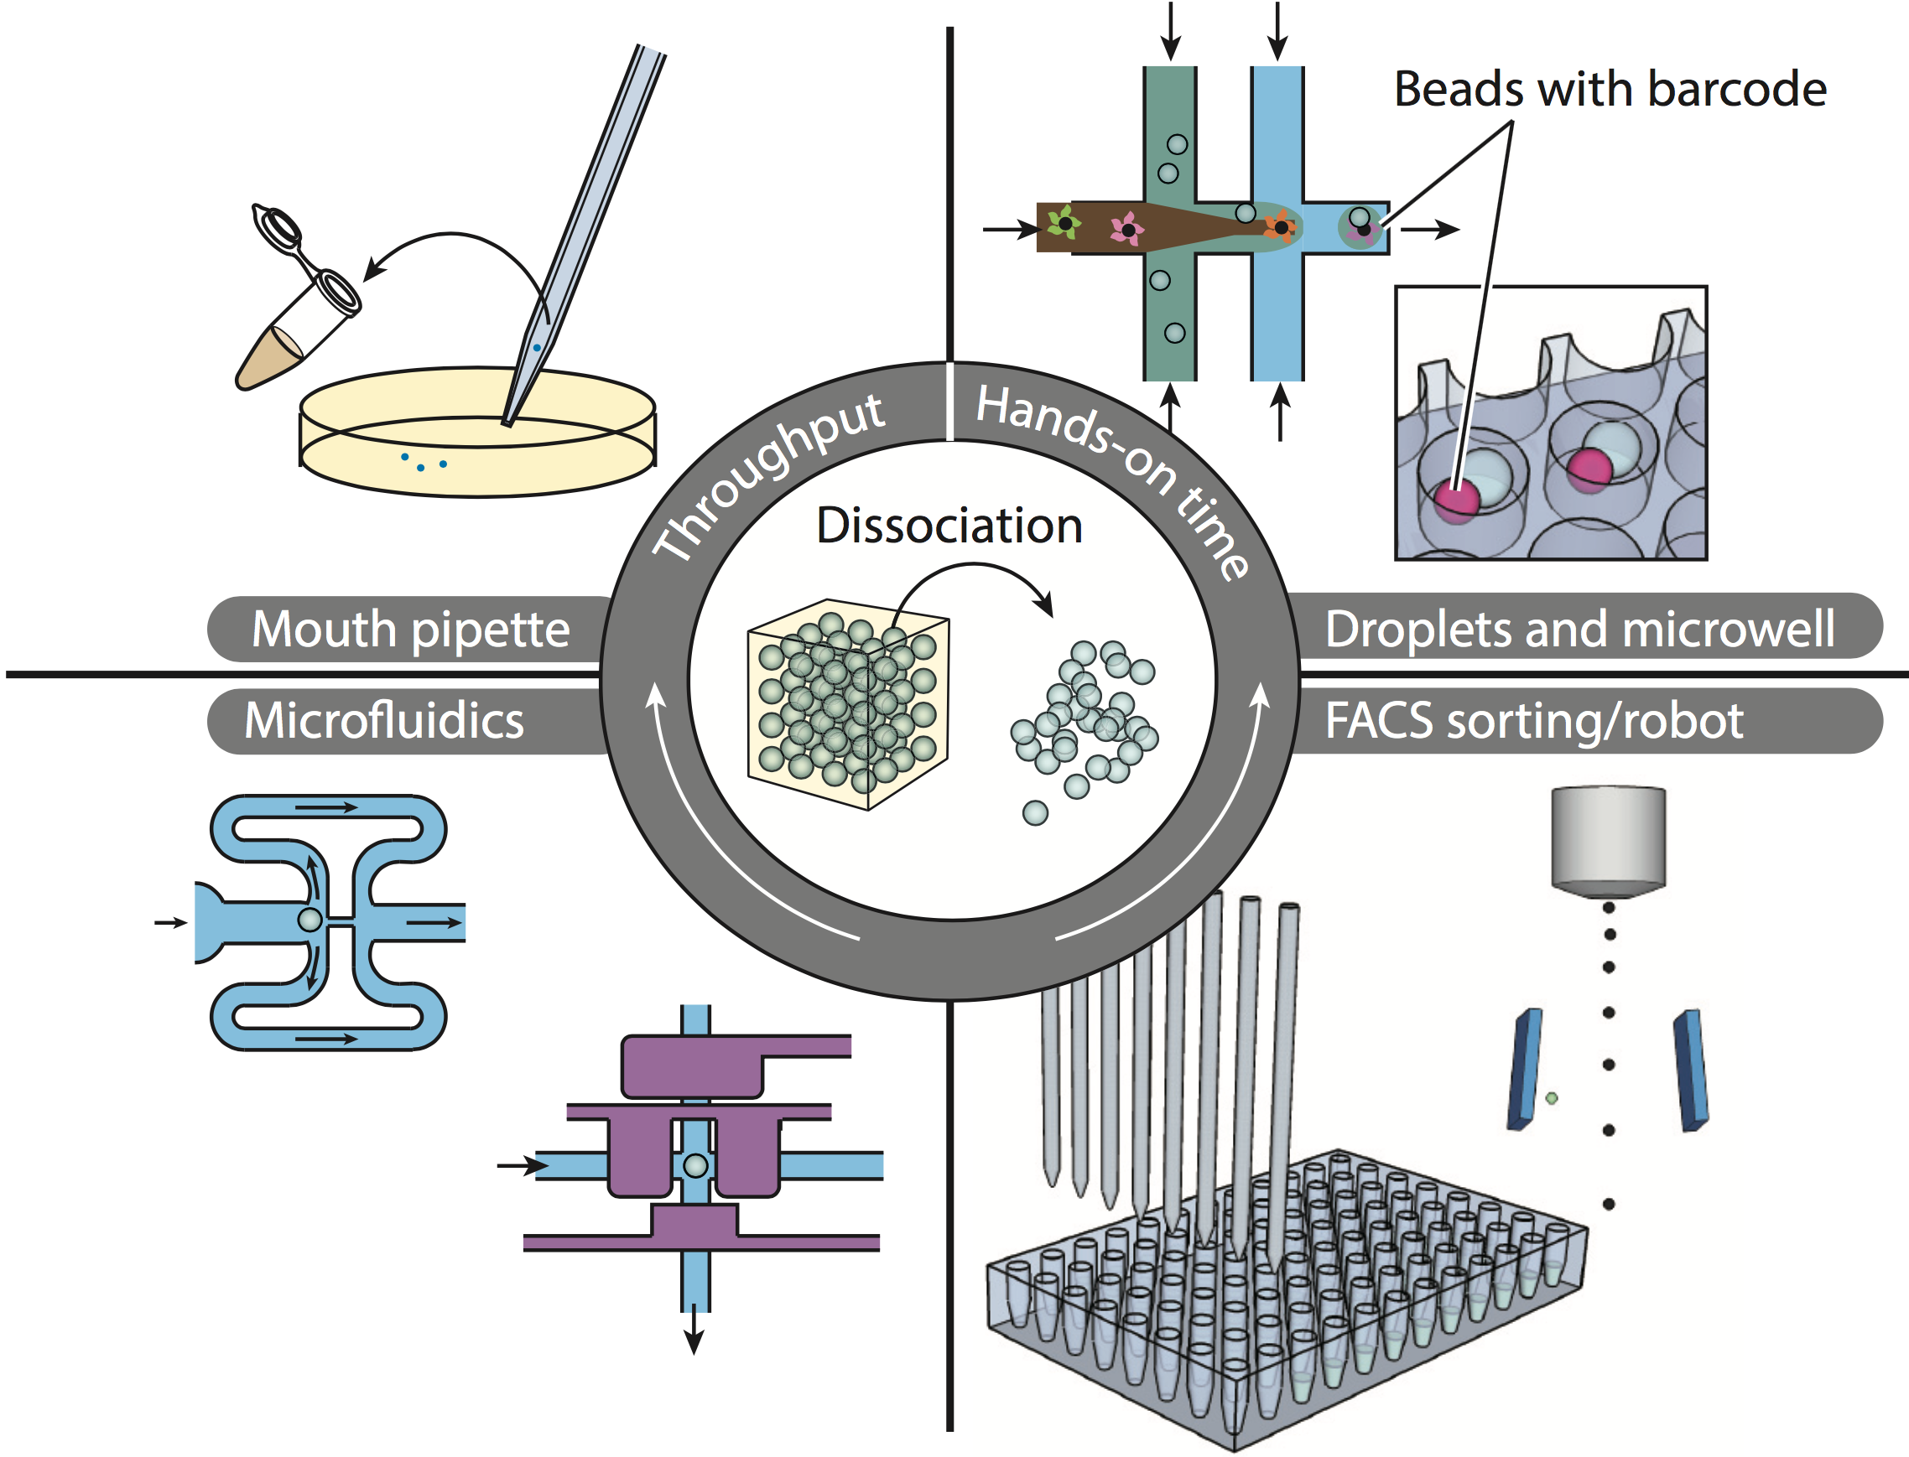
Single cell RNA sequencing
Single cell capture and segregation instruments
scRNA-seq pipelines

Slide 5
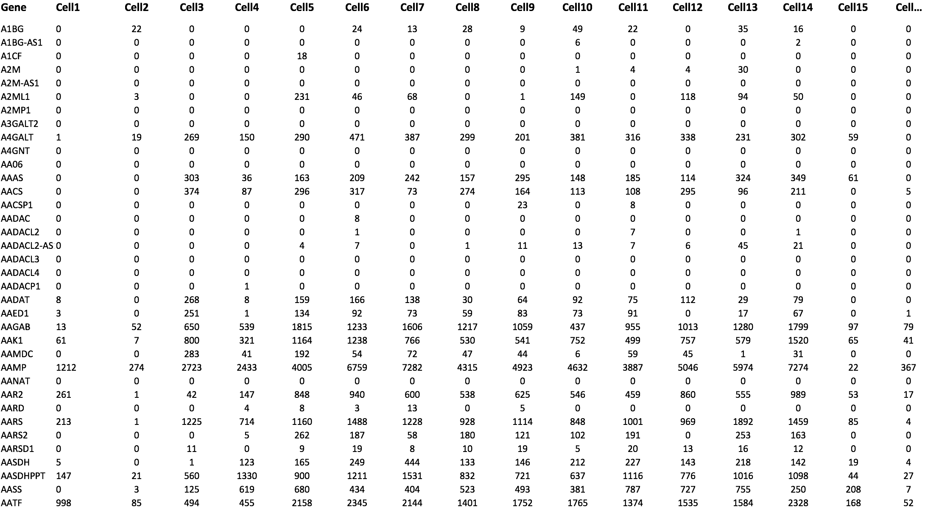
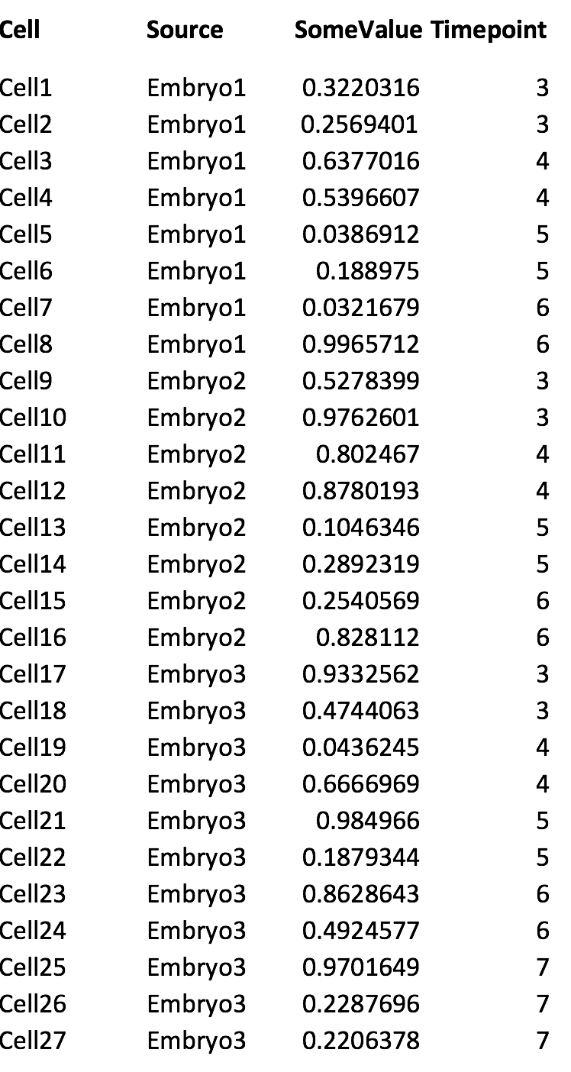
scRNA-seq data
Gene expression data in each cell
Annotation data for each cell

Slide 6
scRNA-seq data analysis
Dimension reduction: PCA, t-SNE
Unsupervised clustering: hierarchical, K-means,biclustering, etc
Co-expression network: PAGODA, etc
Mapping to trajectories: Moncle, Wishbone, SLICER, scTDA

Slide 7
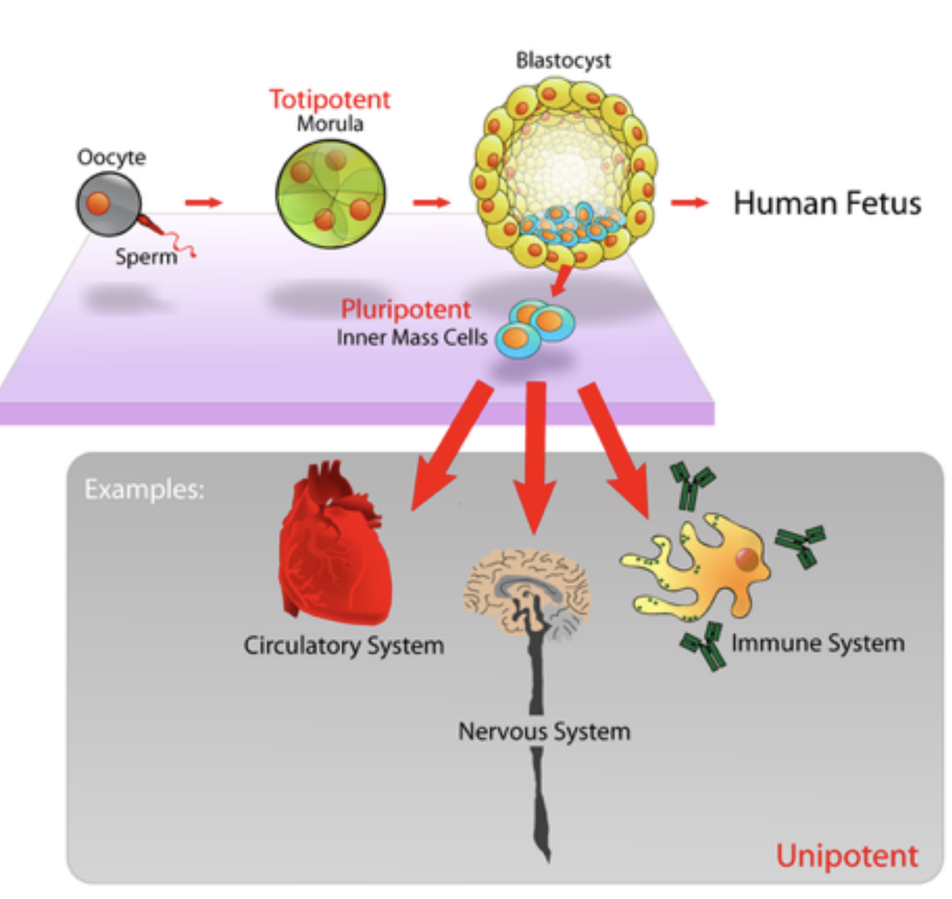
Human embryo development
 | E3 | E4 | E5 | E6 | E7 | Total
Embryos | 13 | 16 | 24 | 18 | 18 | 88
Cells | 81 | 190 | 377 | 415 | 466 | 1529
Petropoulos, Sophie, et al. "Single-cell RNA-seq reveals lineage and X chromosome dynamics in human preimplantation embryos." Cell 165.4 (2016): 1012-1026.

Slide 8
Human embryo development
Data preparing and cleaning
- Mapp to reference genome, count mapped reads for each gene
- Remove cells with low sequencing depth and low mappability

Slide 9
Human embryo development
Filter cells

Slide 10
Human embryo development
Filter genes:
- select genes with relatively high expression, and high variability
195 genes selected (1%)
p.select_genes(avg_counts=2.0, min_z=3.0)

Slide 11
Human embryo development
PCA projection
PC2
PC1

Slide 12
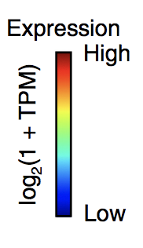
Human embryo development
Topological representation based on PC1 & PC2 using Mapper
- Parameter: 25 x 25 bins with an average of 40% overlap, unrooted
PDGFRA

Slide 13
Human embryo development
Topological representation based on PC1 & PC2 using Mapper
- Parameter: 25 x 25 bins with an average of 40% overlap, rooted
DPPA
c = scTDA.RootedGraph(‘Embryo_mds’, ‘Embryo.no_subsampling.tsv’, posgl=True); c.draw('DPPA5');

Slide 14
Human embryo development
TDA reproduces correctly the differentiation time course
Late
Embryo day
Early
Time

Slide 15
Human embryo development
Pseudotime based on topological representation
High
Low
Distance
Root node

Slide 16
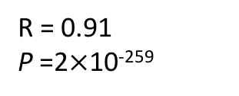
Human embryo development
Pseudotime based on topological representation
R = 0.91
P =2$×$10⁻²⁵⁹

Slide 17
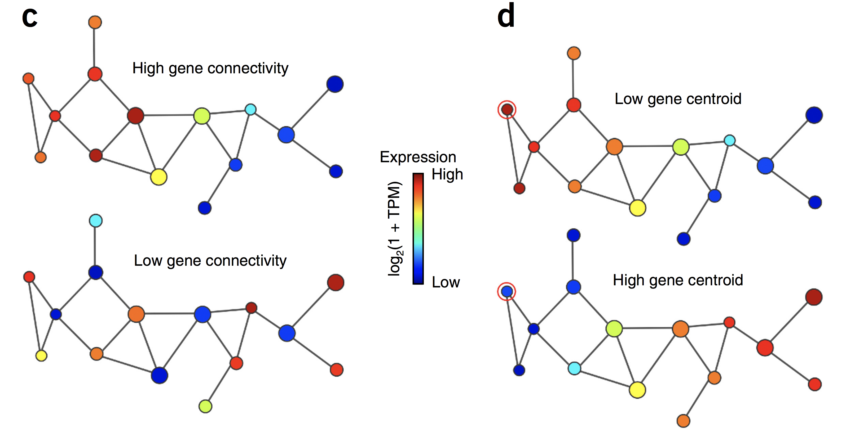
Human embryo development
Connectivity and centroid

Slide 18
Human embryo development
Cell subpopulation identification based on centroid and dispersion

Slide 19
Human embryo development
scTDA identified transient sub-populations during embryo differentiation.
Root node

Slide 20
Reference and links
scTDA: https://github.com/RabadanLab/scTDA
Tutorial: https://www.dropbox.com/s/ma80a641miteyxf/scTDA%20Tutorial.tar.gz?dl=1
Methods: https://www.nature.com/articles/nbt.3854.pdf
Dataset: www.cell.com/cell/abstract/S0092-8674(16)31058-3

